Slide 1

APACHE POI INSTALLATION

Slide 2
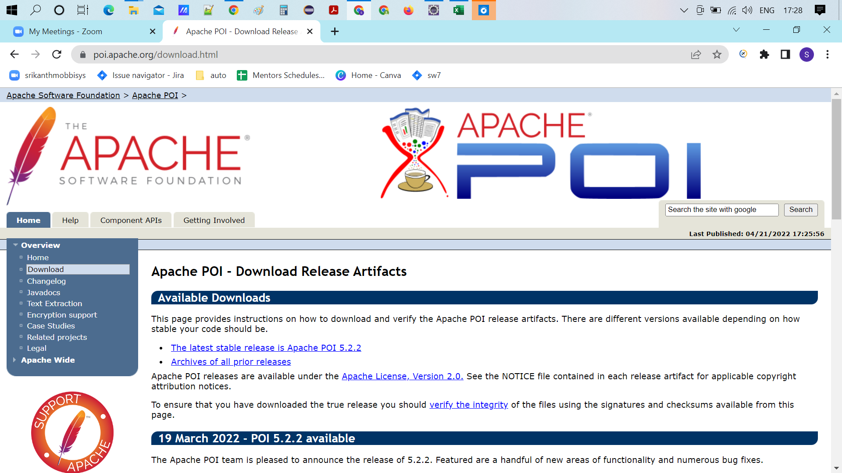

Slide 3
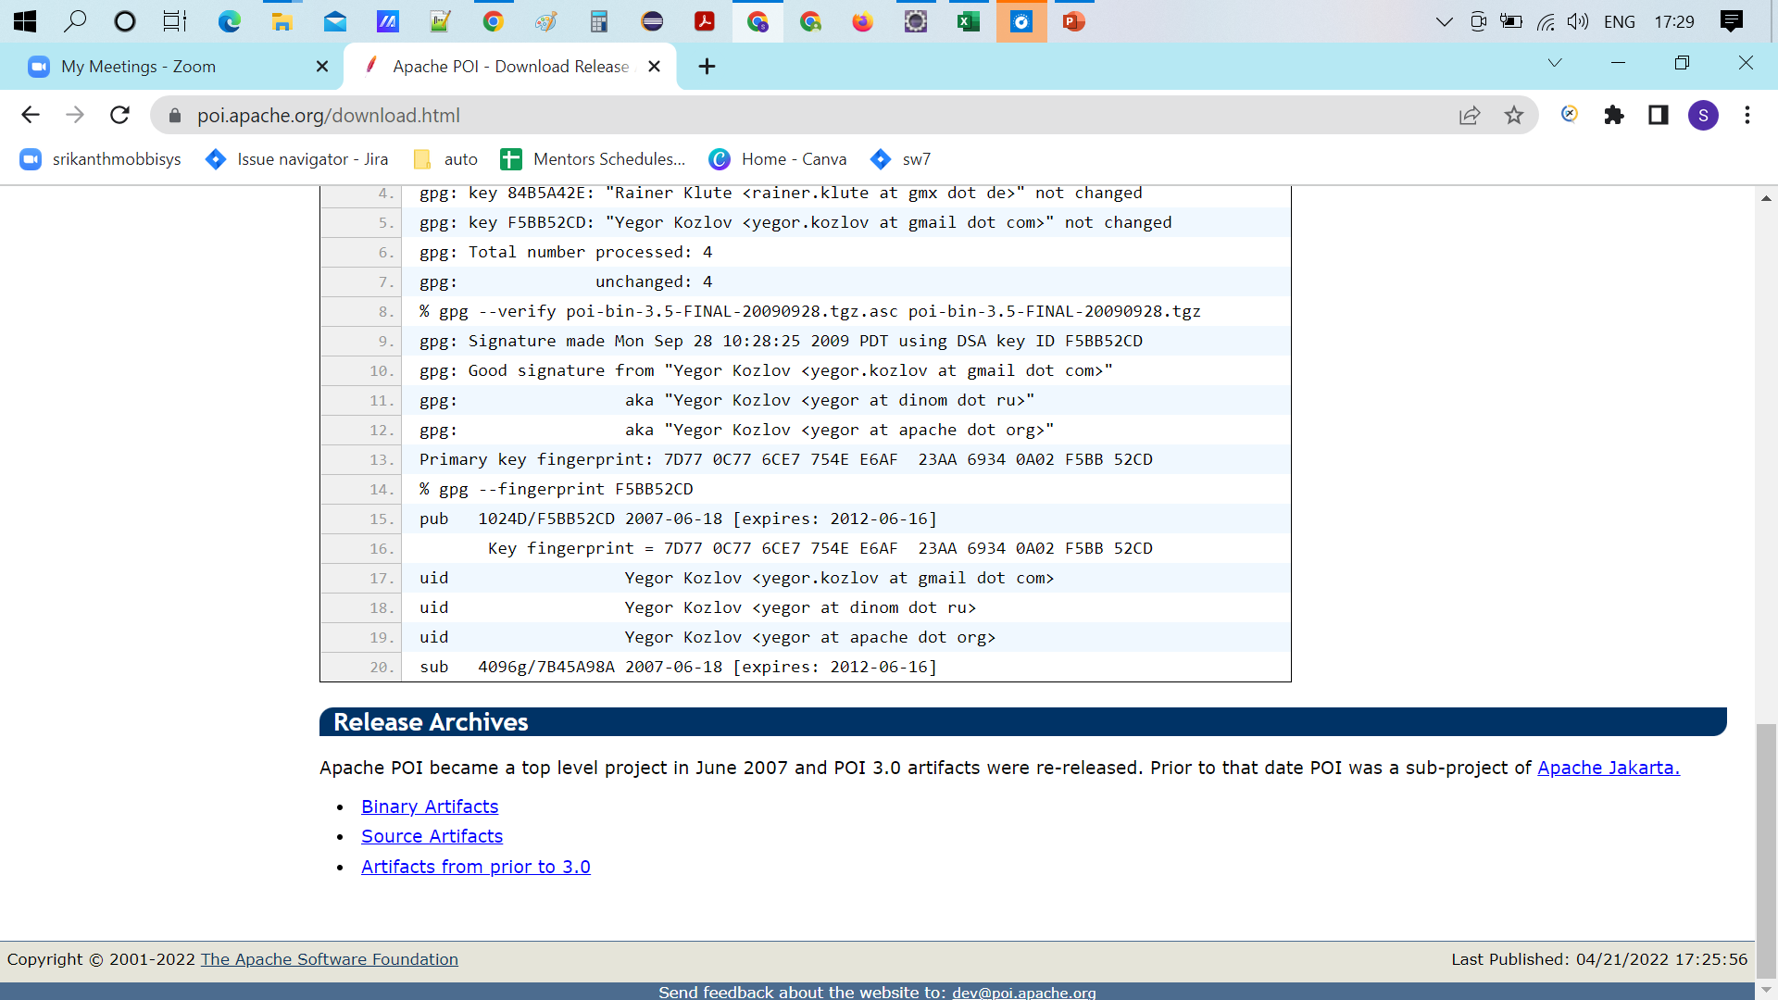


Slide 4
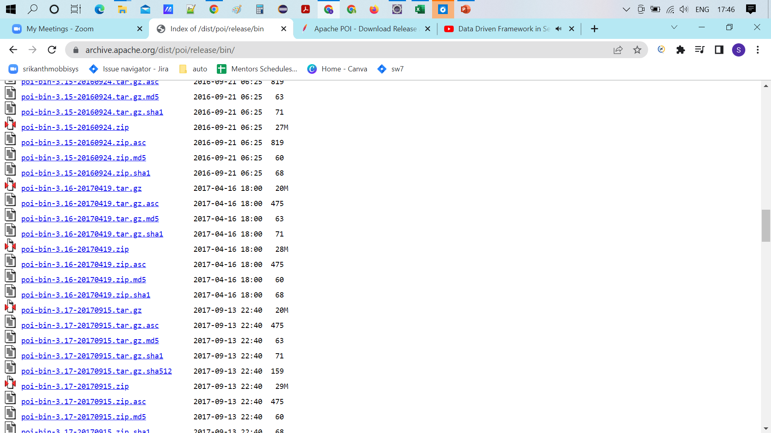

Slide 5
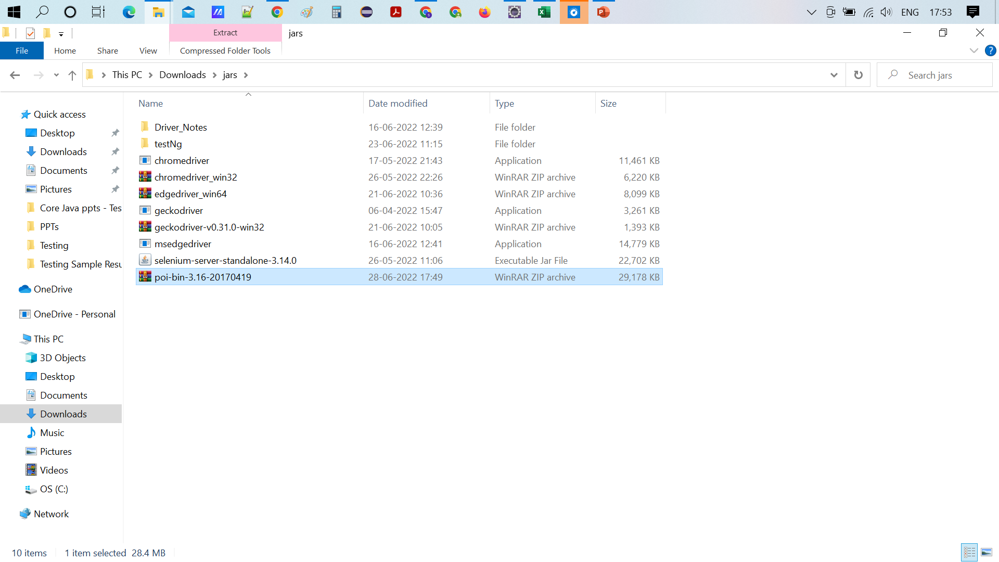

Slide 6
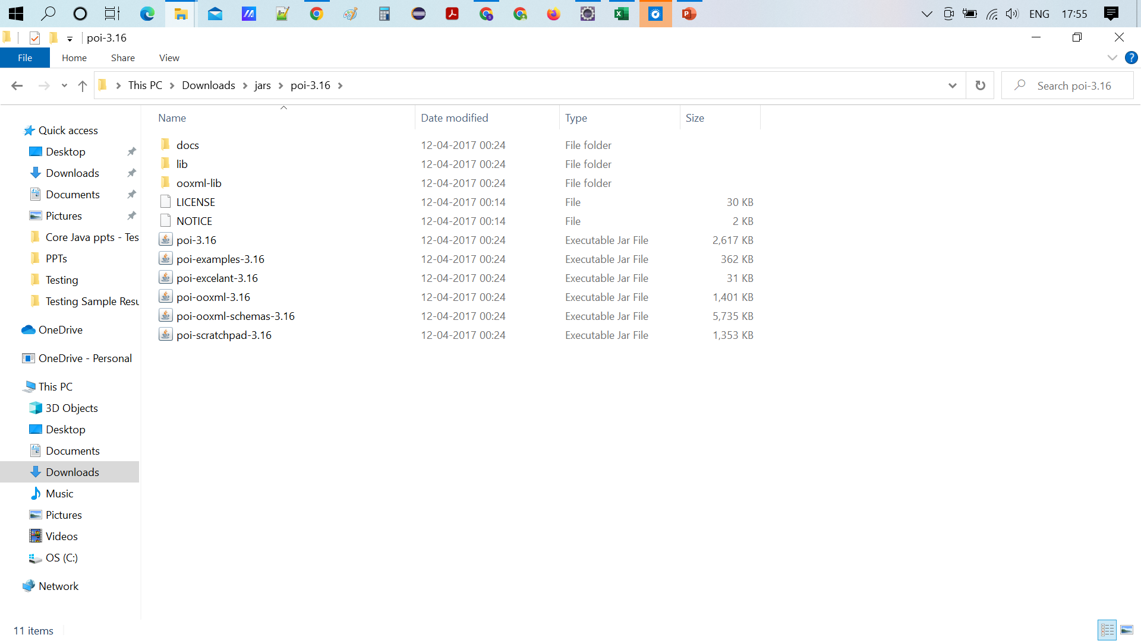
After extracting the zip file, add all the jar files to the project along with the Lib & ooxml-lib jar files

Slide 7
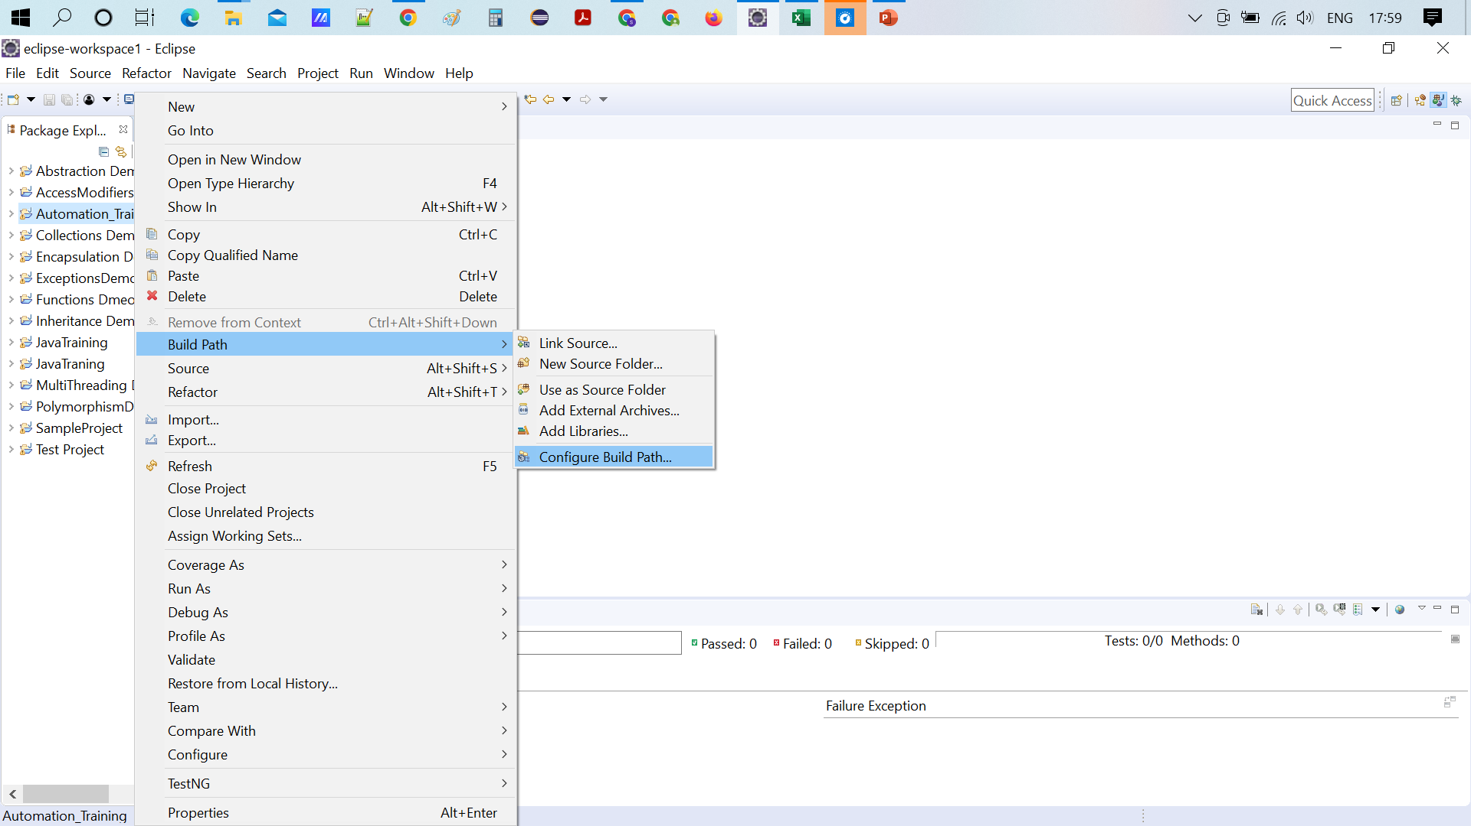

Slide 8
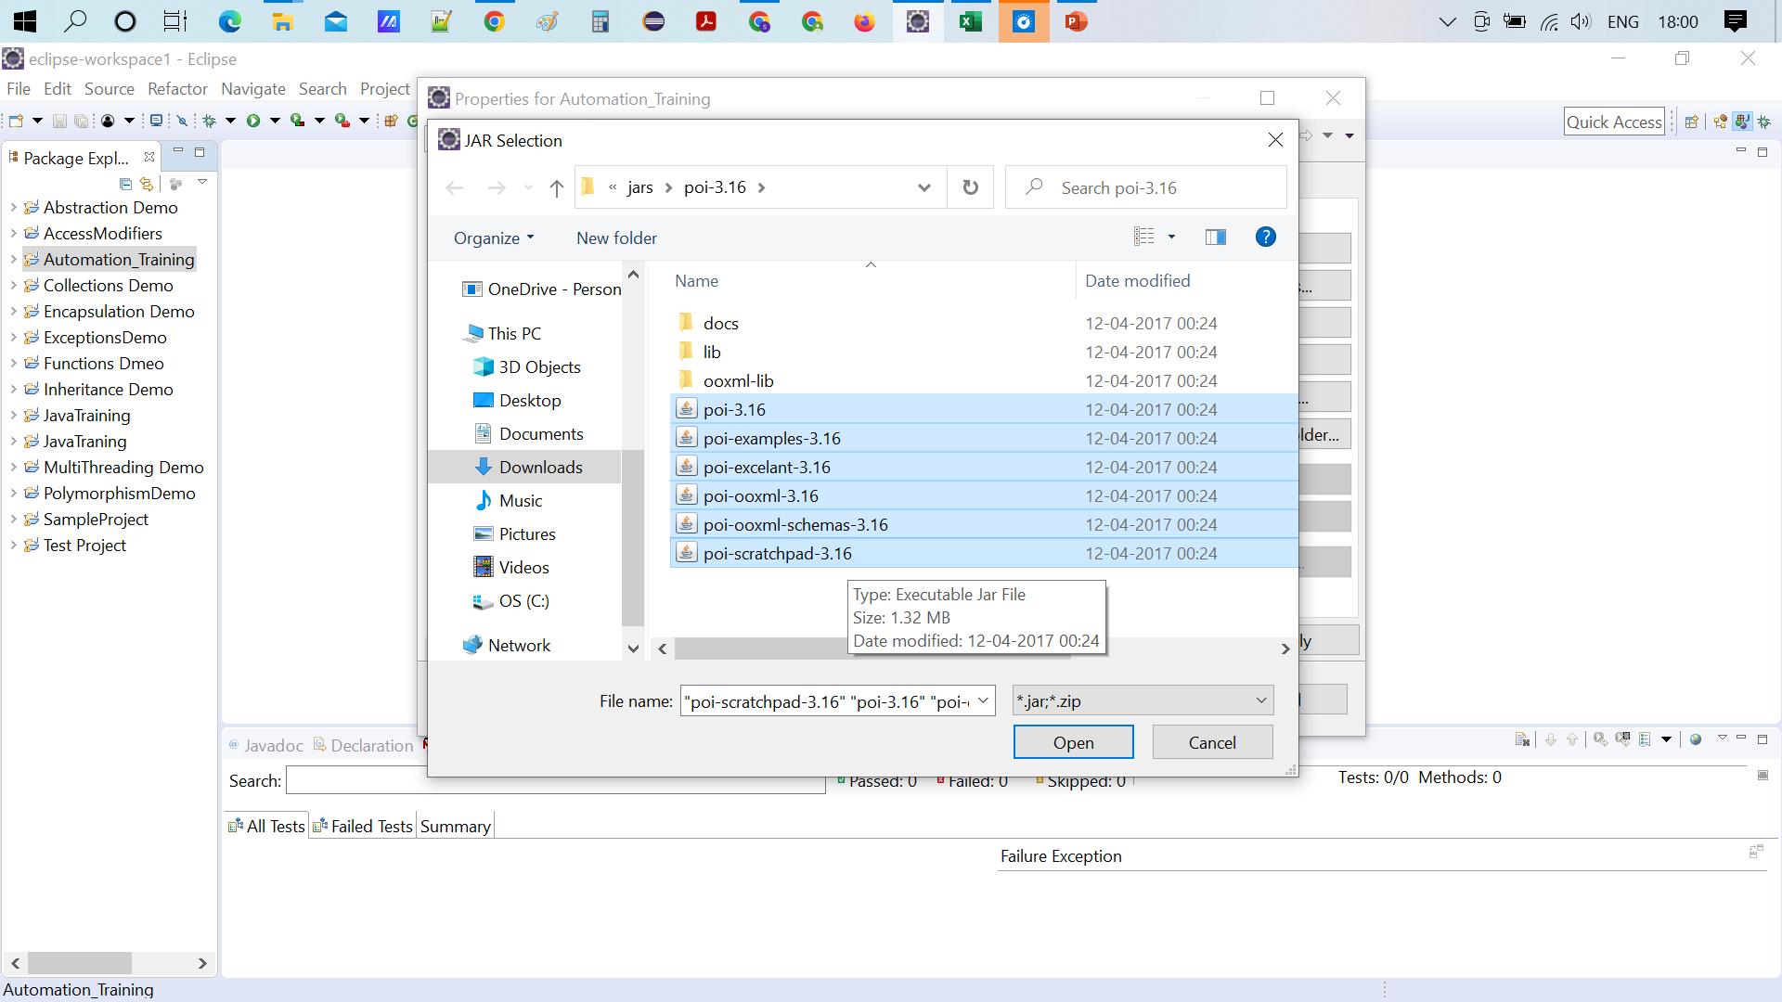

Slide 9
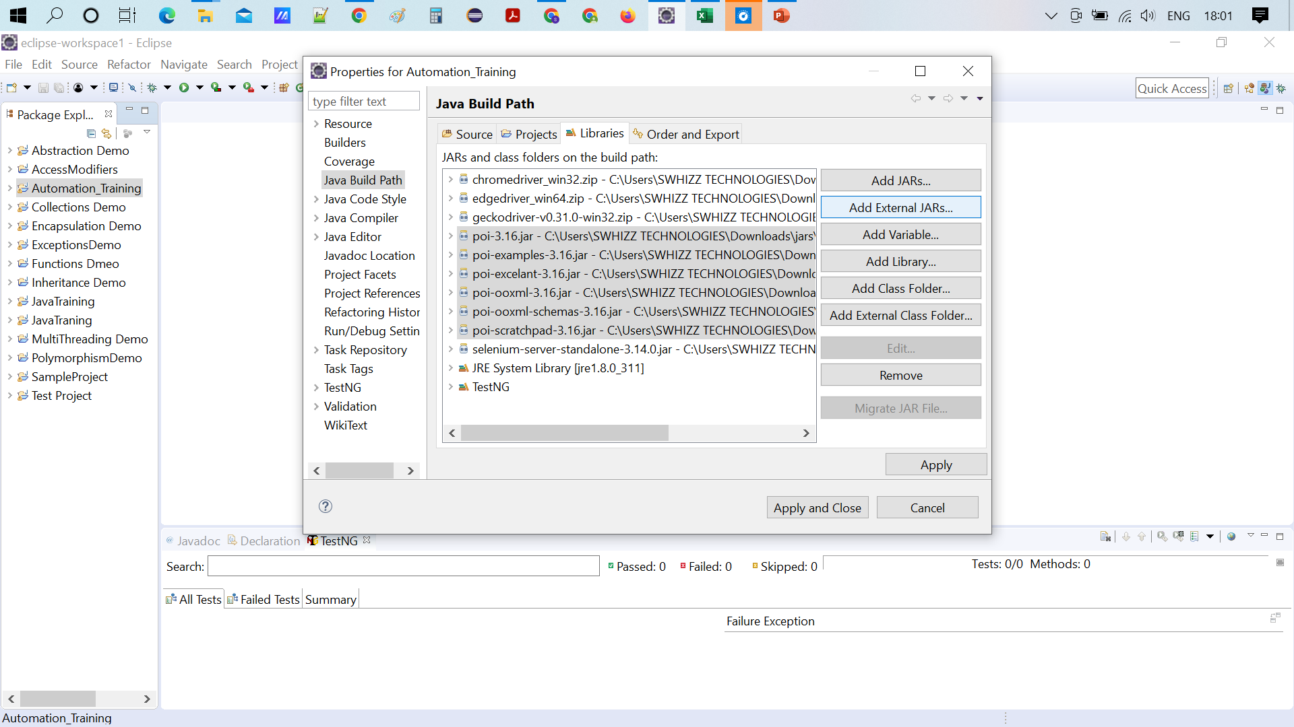

Slide 10
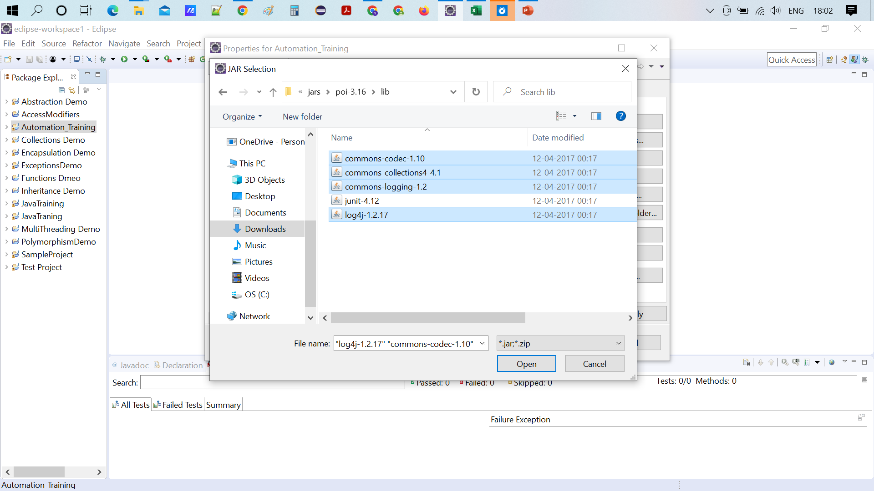

Slide 11
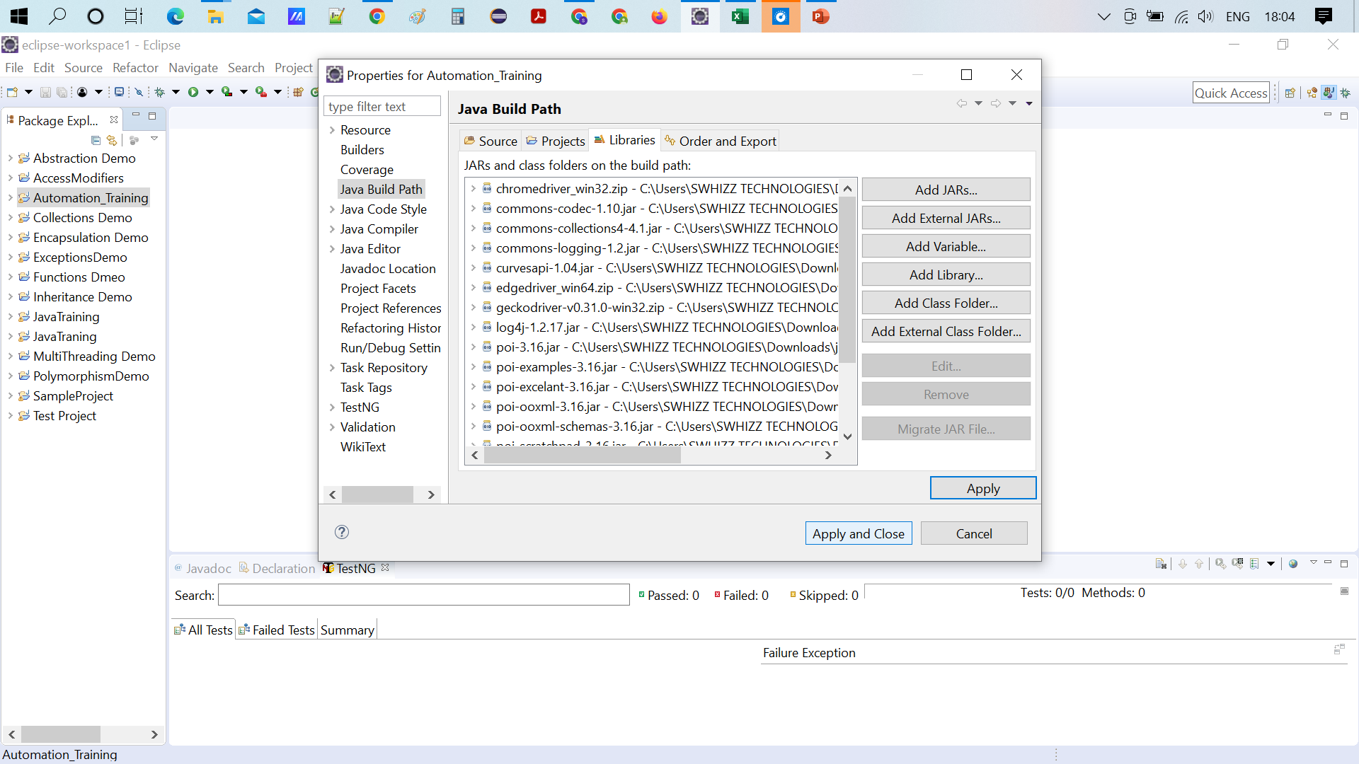

Slide 12
Why Swhizz?
Follow the project-oriented training
One to One monitoring
Work on user stories
Expertise in resume preparation
Mock interviews
Job assistance
Real time people will deliver the classes
Hand on experience.
50+ Client connections for placement

Slide 14
Any Queries?

Slide 15
Thank You
Mr.SubbaRao (Relationship Manager)
Contact:9059002244

